Slide 1

Ventilation and Energy Control System
Safety Air Safety Goods & Energy saving

Slide 2
Supervised By :
Prof: Moheb Ramzy Girges
TA: Mina Samman

Slide 3
Prepared By:
Milad Ezzat
Amgaad Ezzat
Ragaa Maher
Keroles Ibrahim
Adel Abid
John Latif

Slide 4
Agenda:
Introduction
Problems
Solution
background
Planning phase
Analysis phase
Software artifacts
Project designs

Slide 5
Introduction
Industrial countries
Air pollution
Consumption energy.
Filed we choose for implement the project

Slide 6
Agenda:
Introduction
Problems
Solution
background
Planning phase
Analysis phase
Software artifacts
Project designs

Slide 7
Problems
The Manufacturing Process of sugar problems:
Extraction process cause of producing:
humidity and dust.
Evaporation stage:
temperature and troubles in the pressure as a result of heating,
CO2 and GUYER (which cause of losing sight and chest allergy).
Boiling stage cause of increasing :
temperature, pressure and humidity
packaging stage:
sugar can be infected, if it exposure to high temperature or humidity.
Some gases produced with Manufacturing :
NO2
CO
Energy consumption

Slide 8
Agenda:
Introduction
problems
Solution
background
Planning phase
Analysis phase
Software artifacts
Project designs

Slide 9
Solution??
Current Solution
VECS

Slide 10
Agenda:
Introduction
Problems
Solution
Background
Planning phase
Analysis phase
Software artifacts
Project designs

Slide 11
background
IoT
Hardware
Arduino
Software
Desktop application
Web application
Android application

Slide 12
Agenda:
Introduction
Problems
Solution
Background
Planning phase
Analysis phase
Software artifacts
Project designs

Slide 13
Planning phase
System request
Working plan
Gant chart

Slide 14
System Request:
project sponsor:
Business need
Business requirements:
Business value
Tangible benefits
Intangible benefits
Special issues & Constraints

Slide 15
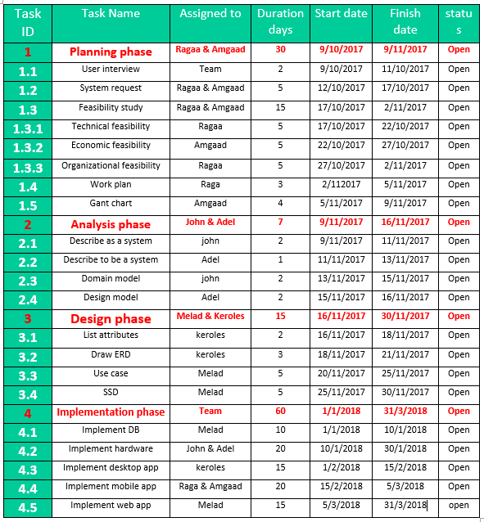
Work Plan

Slide 16
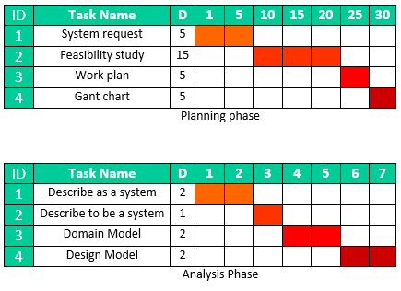
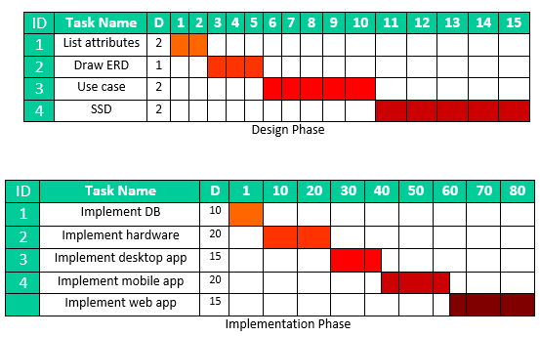
Gant chart
Gant chart
Gant chart

Slide 17
Agenda:
Introduction
Problems
Solution
Background
Planning phase
Analysis phase
Software artifacts
Project designs

Slide 18
Analysis phase
Feasibility study
Technical feasibility
Economical feasibility
Risks

Slide 19
Feasibility study
Technical feasibility
Familiarity with application
Help the factory to improve its product and protect the workers from harmful gases.
Familiarity with technology
We will use Arduino, web (html, CSS, java script, JQuery ) and android (java, xml ).
Project size
Our team consists of six persons and we can finished our project in one year.

Slide 20
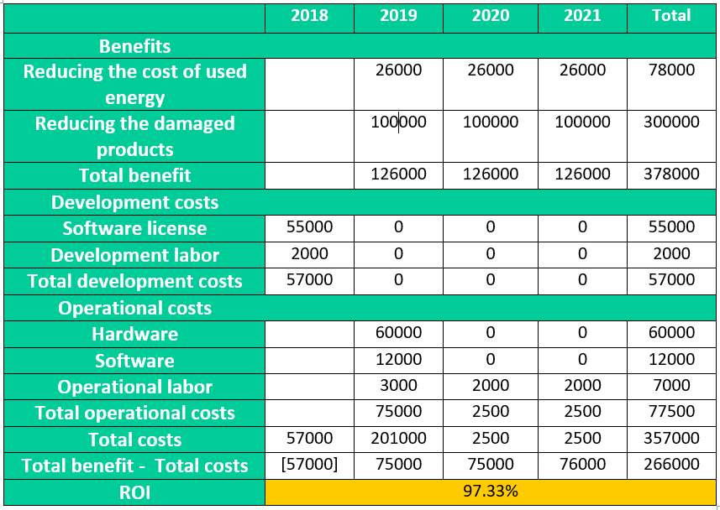
Economic feasibility

Slide 21
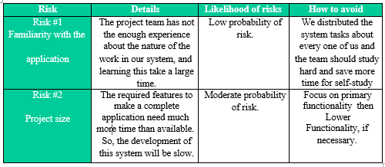
Risks

Slide 22
Agenda:
Introduction
Problems
Solution
Background
Planning phase
Analysis phase
Software artifacts
Project designs

Slide 23
Software Artifacts
Actors & Goals
Use case diagram
SSD
Conceptual classes
Domain model
Contracts
Design model
ERD

Slide 24
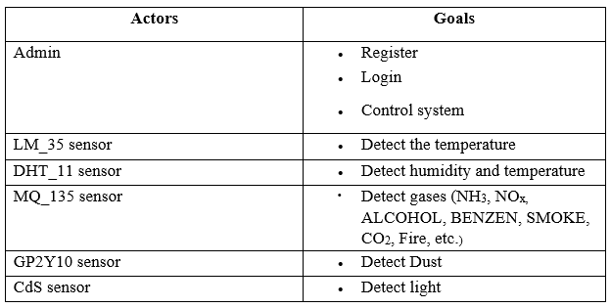
Actors & Goals

Slide 25
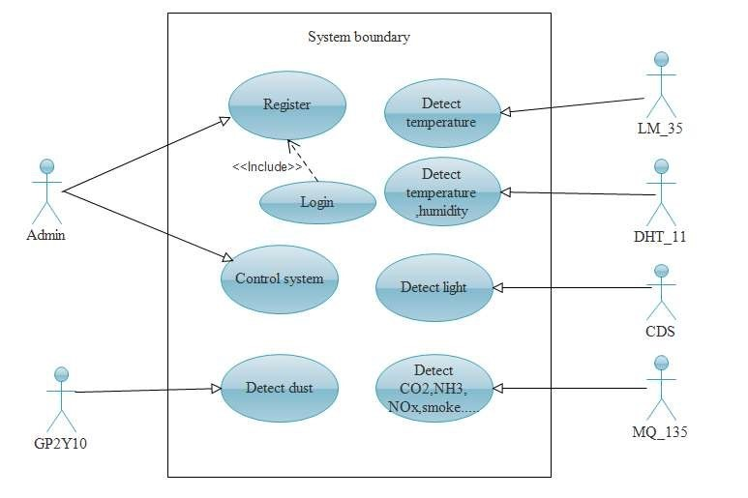
Use case diagram

Slide 26
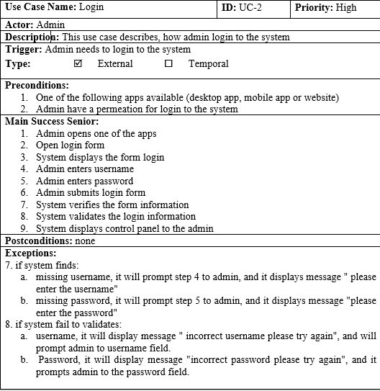
Use Example

Slide 27
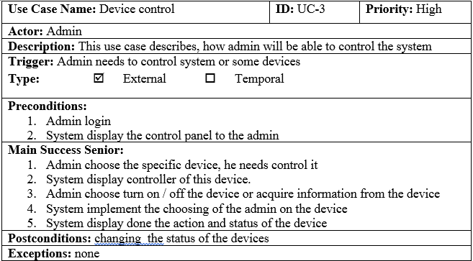
Use Example

Slide 28
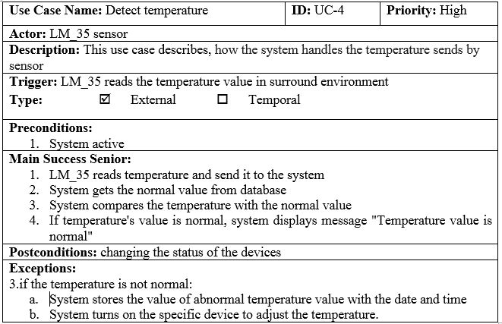
Use Example

Slide 29
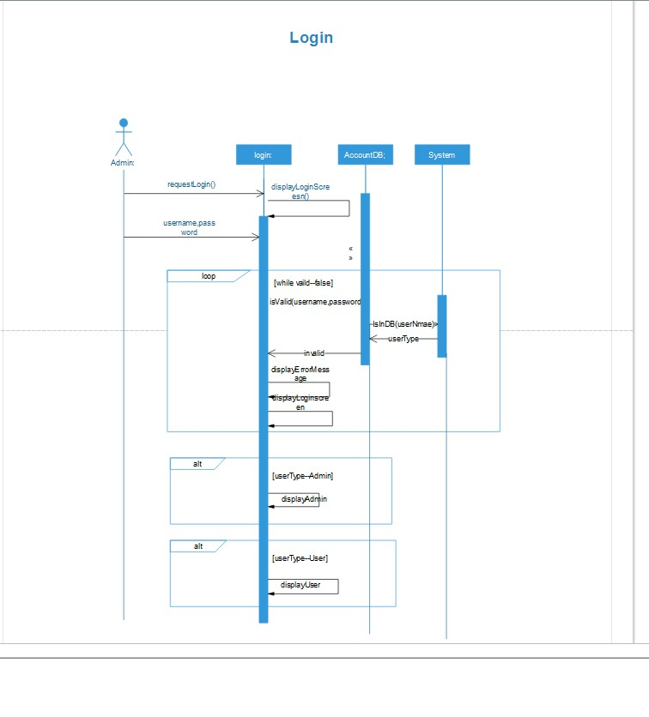
SSDs

Slide 30
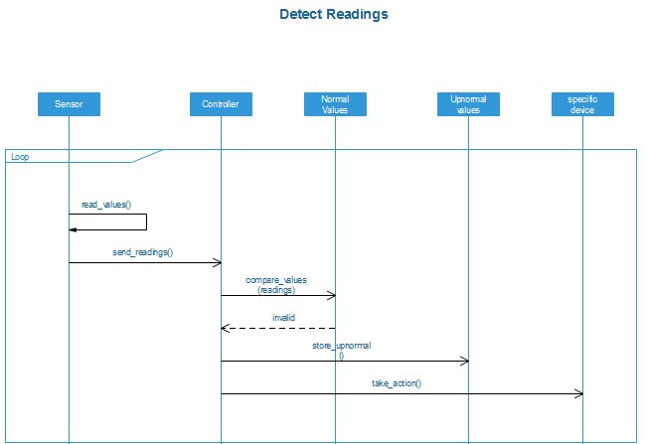
SSDs

Slide 31
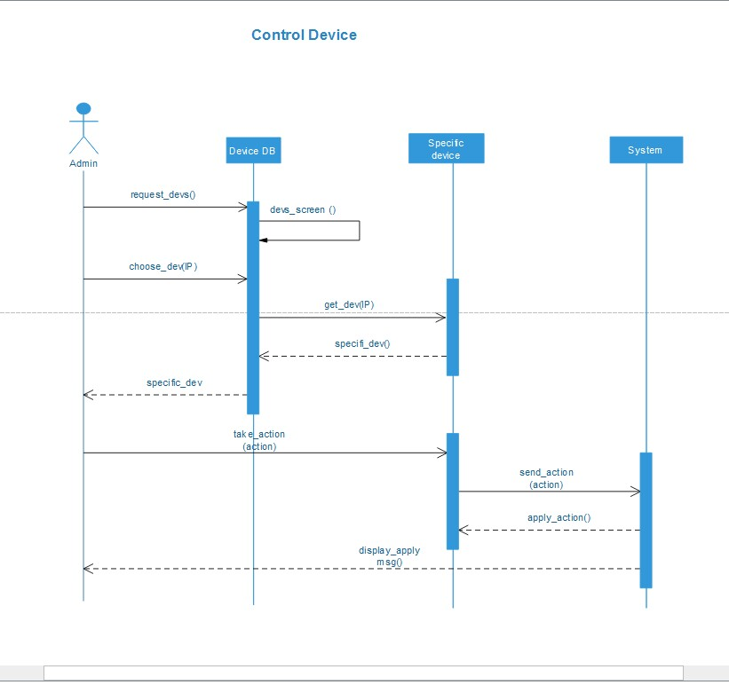
SSDs

Slide 32
Conceptual classes
DHT_11 sensor |  | GP2Y10 sensor |  | CDS sensor |  | Normal values |  | System |  | Factory |  | Admin
Network |  | Readings |  | Date |  | Time |  | Environment |  | MQ_135 sensor |  | LM_35 sensor
Controller |  | Desktop app |  | Registration |  | Username |  | Password |  | Devices |  | Sensors

Slide 33
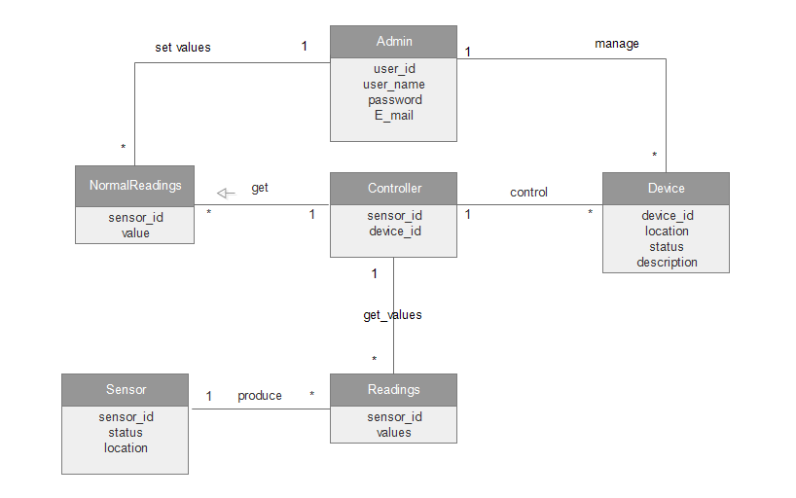
Domain model

Slide 34
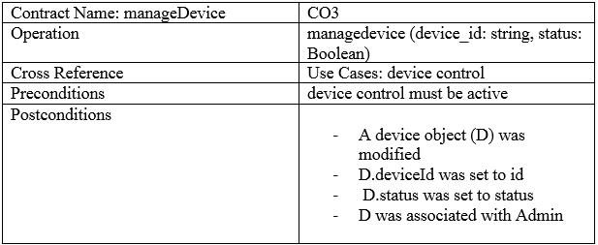
Contracts

Slide 35
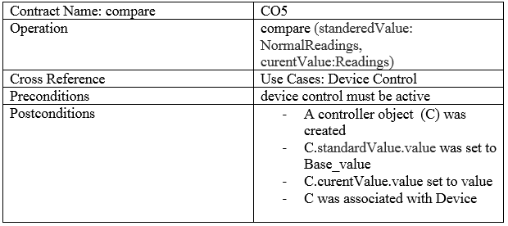
Contracts

Slide 36
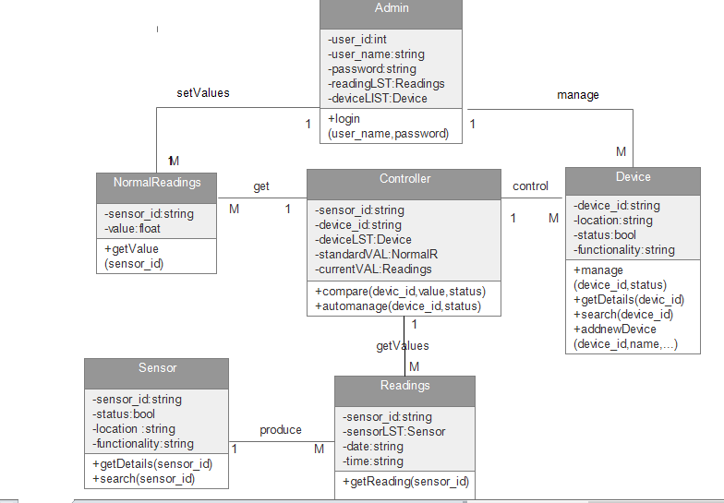
Design Model

Slide 37
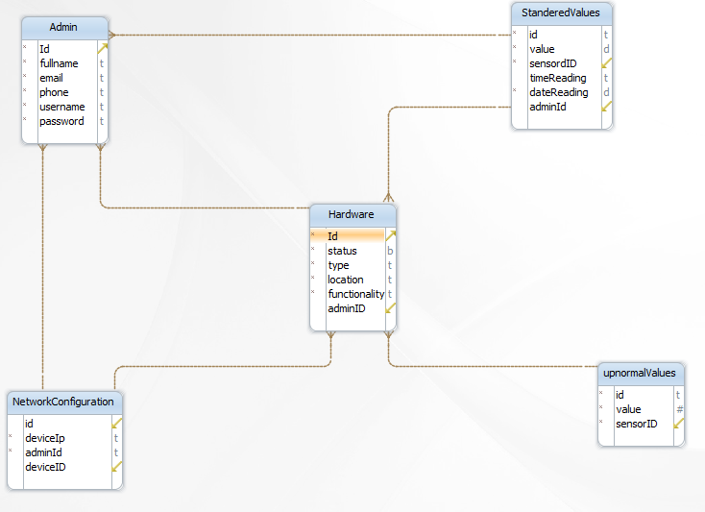
ERD

Slide 38
Agenda:
Introduction
Problems
Solution
Background
Planning phase
Analysis phase
Software artifacts
Project designs

Slide 39
Project designs
Desktop Design
Mobile App Design
Web App Design

Slide 40
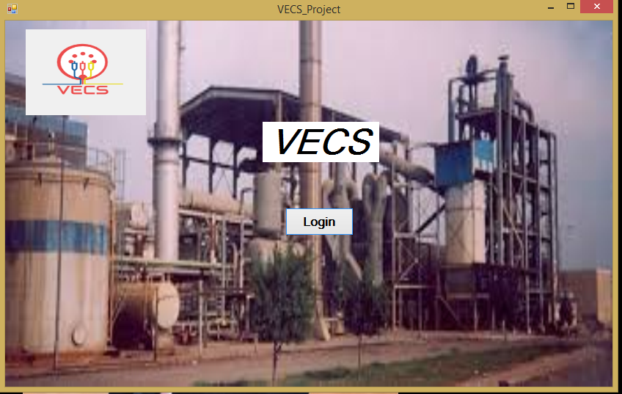
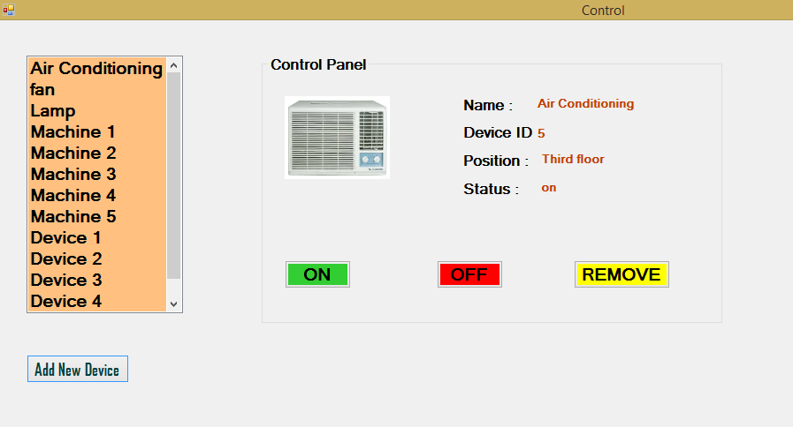
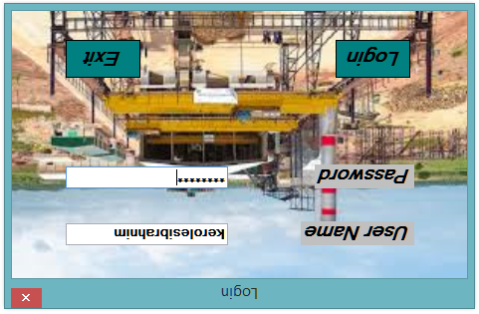
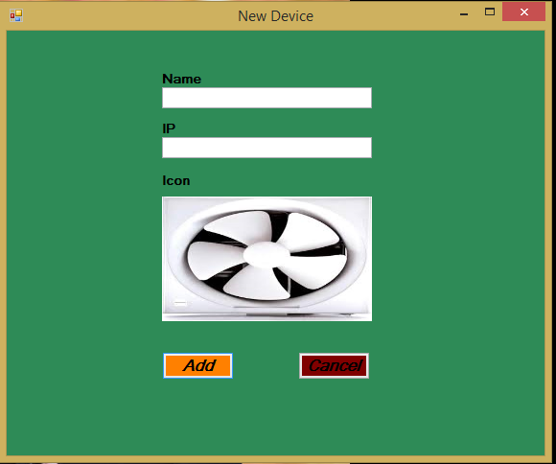
Desktop design

Slide 41
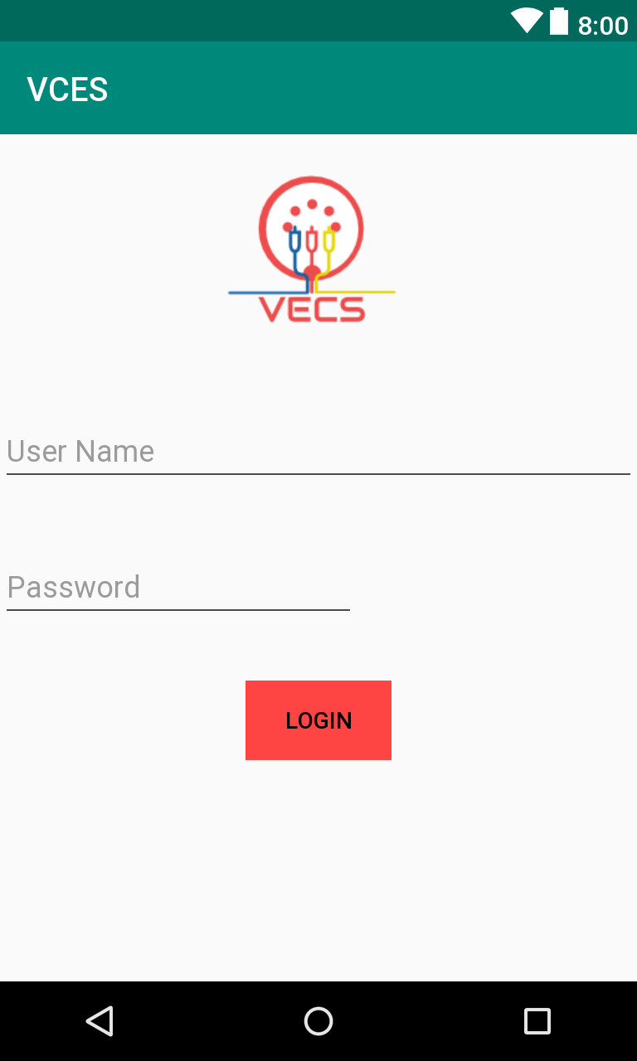
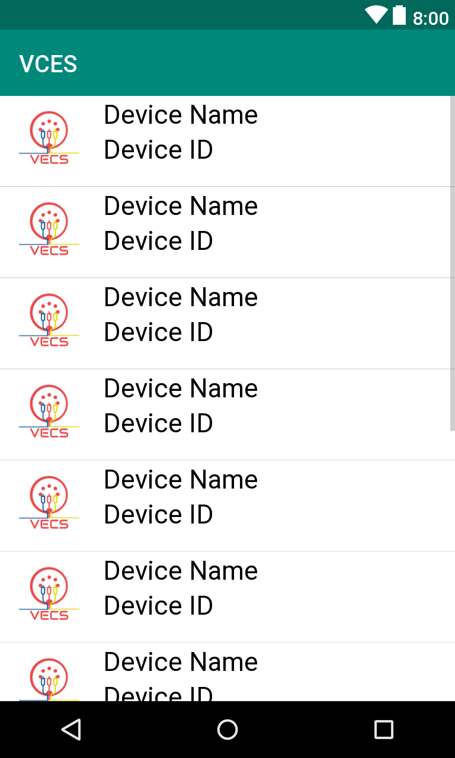
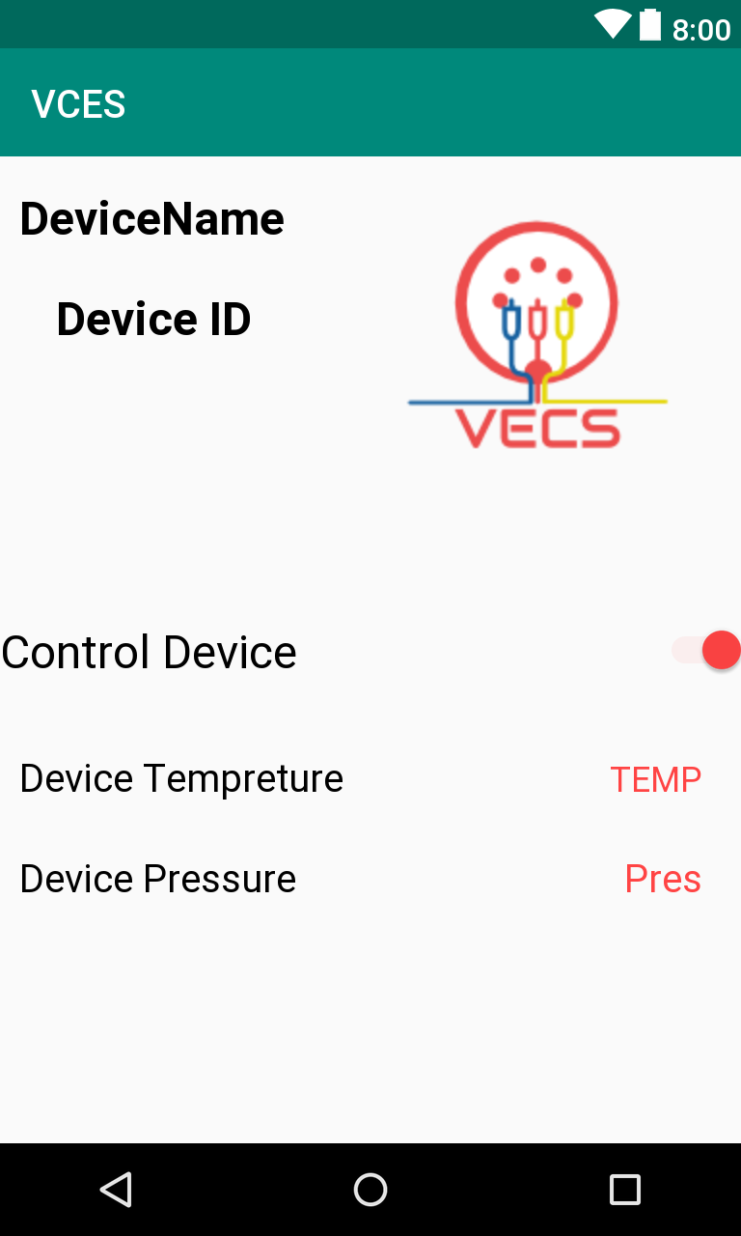
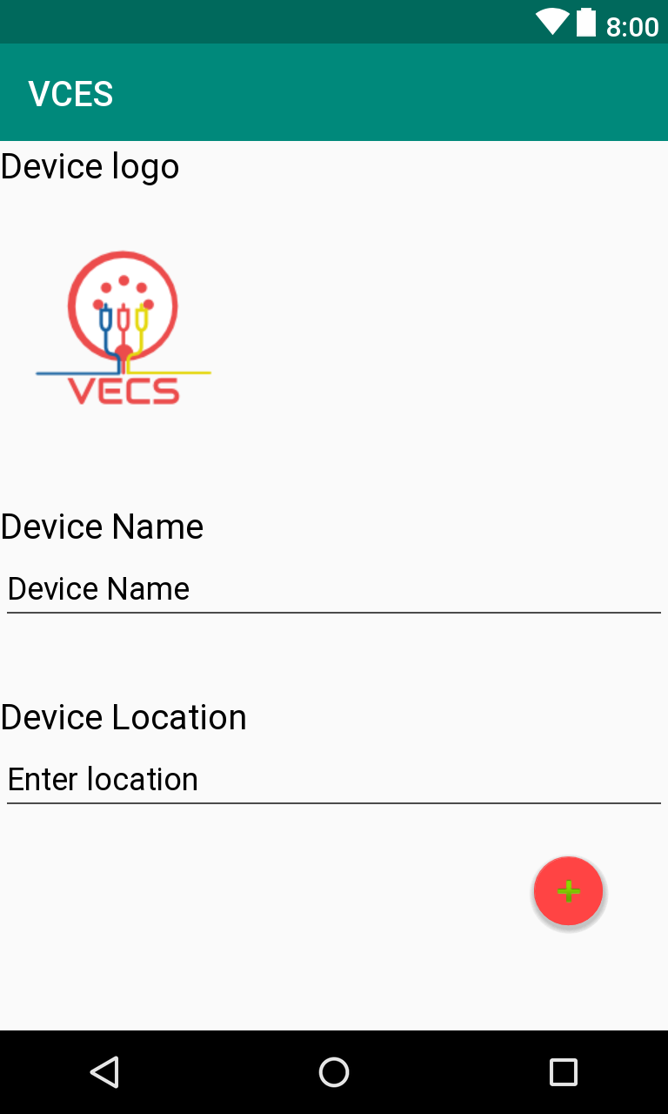
Mobile design

Slide 42
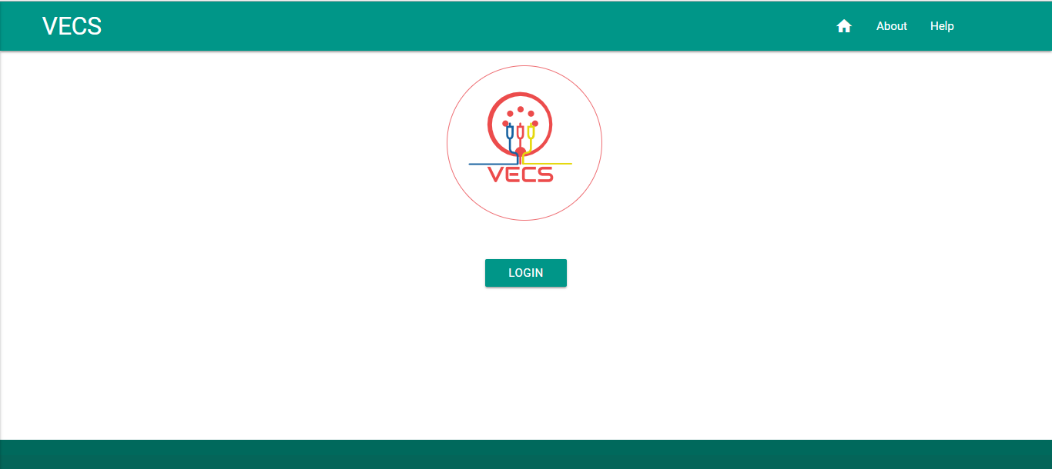
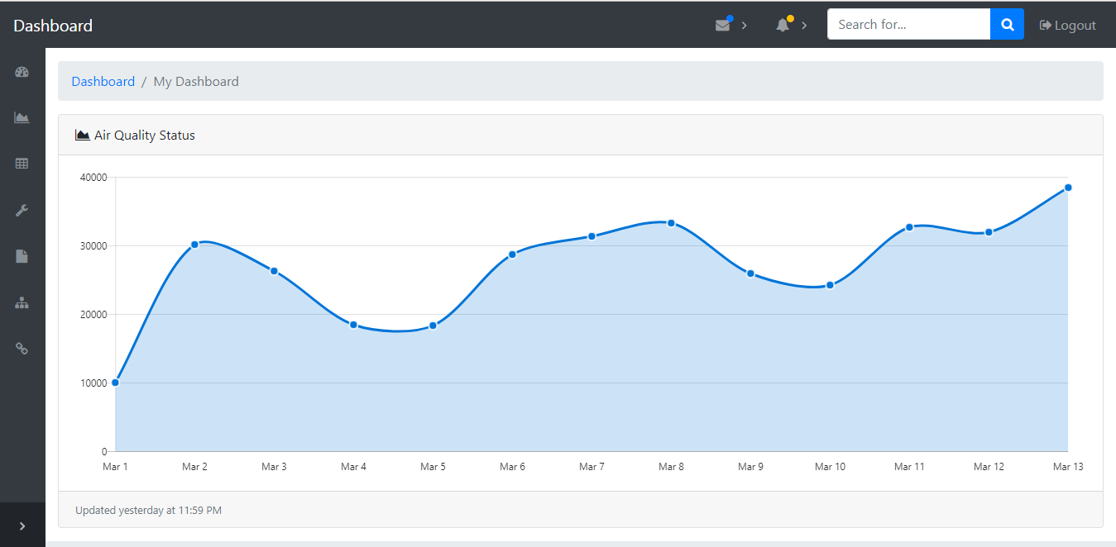
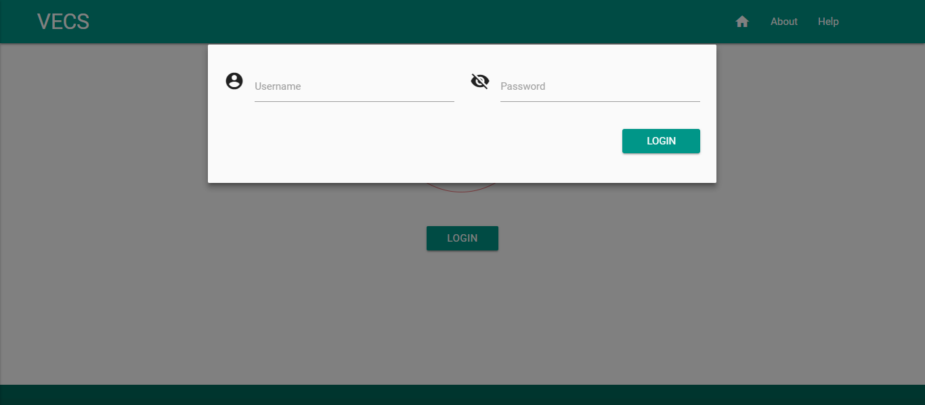
Web designs

Slide 43
Thanks

